Slide 1
VR Game Development Introduction
Dr. Brian Schrank
School of Design, DePaul University

Slide 2
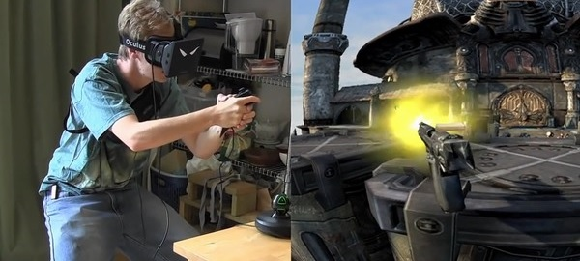
VR is not just an Add-on

Slide 3
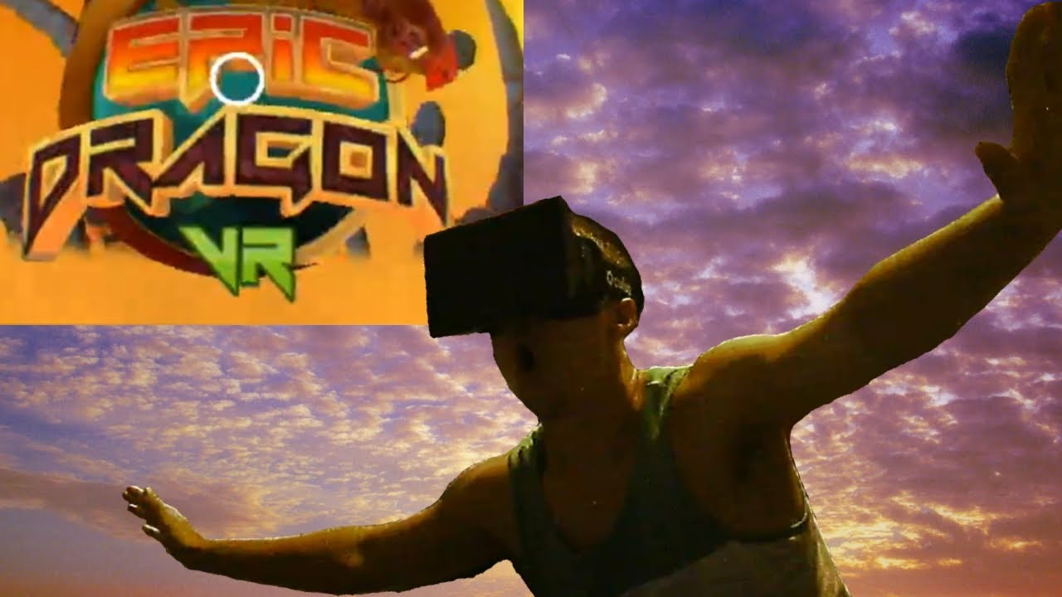
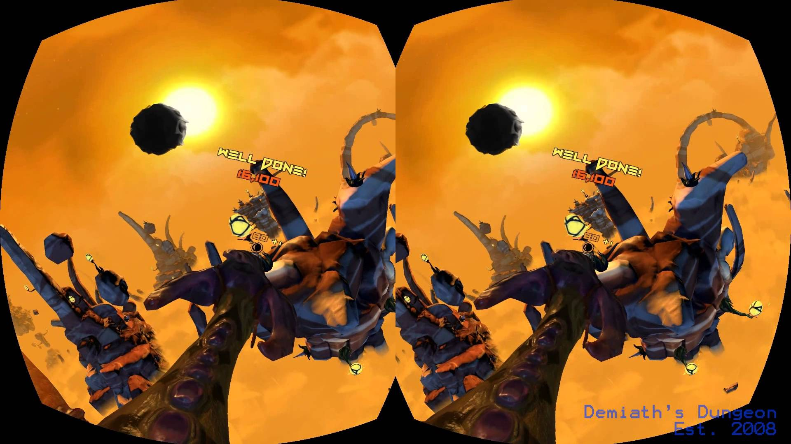
VR is not just an Add-on

Slide 4
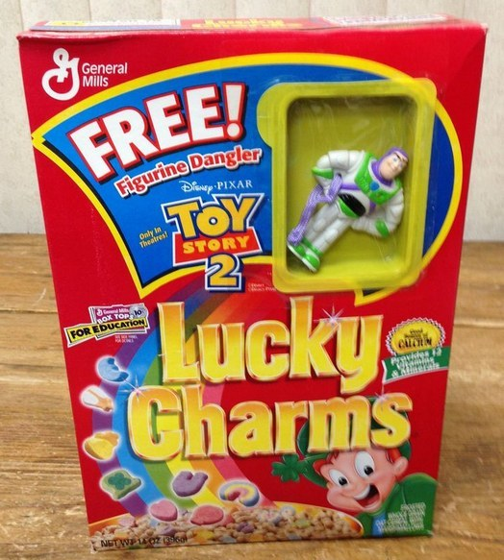
What VR is
What we seem to want it to be
These just
more “real”

Slide 5
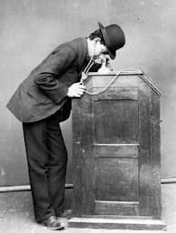
What VR is
What we seem to want it to be
Light-hearted or gimmicky fun for minutes
Fully engaging human experience for hours
This took a while

Slide 6
What VR is
What we seem to want it to be
Light-hearted or gimmicky fun for minutes
Fully engaging human experience for hours
???

Slide 7
So how can we develop for VR?

Slide 8
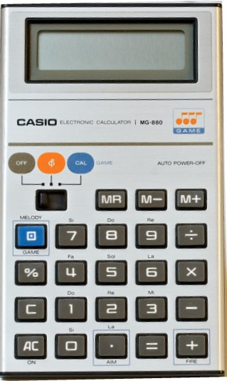
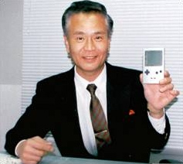
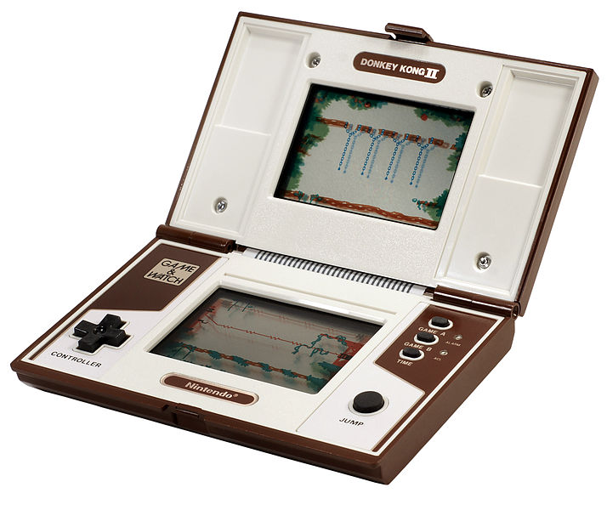
“Lateral Thinking with Withered Technology” —Gunpei Yokoi (inventor of Game Boy)
How to design play with cheap
well-understood tech?
Notes:
Yokoi saw a bored businessman playing with an LCD calculator by pressing the buttons and came up with Game & Watch and ultimately the Game Boy.
Cheap and well-understood tech

Slide 9
Lateral Thinking with Emerging Technology
Notes:
Yokoi saw a bored businessman playing with an LCD calculator by pressing the buttons and came up with Game & Watch and ultimately the Game Boy.

Slide 10
Initial Goals of Dumpy (2013)
When the first Rift came out I wanted to make a landmark game on the platform
Invite everyone to have fun on platform
Pick-up-and-play
Identify, use unique affordances of platform
Had to feel like a “Rift” game (not just a port)
Hands-free
Only input is head rotation
Ex. Looking down with wrecking ball hanging from face

Slide 11
Notes:
Markiplier video
Go to credits on Dumpygame website

Slide 12
Developing Dumpy
Once toy was made, development was obvious: smash lots of cartoon shit...
Notes:
Once toy was prototyped and was fun right away the game asked for shit to throw at the toy

Slide 13
Developing Dumpy
Once toy was made, development was obvious: smash lots of cartoon shit...
Hitting lots of cartoon shit into other shit

Slide 14
Developing Dumpy
Once toy was made, development was obvious: smash lots of cartoon shit...
Hitting lots of cartoon shit into other shit
Setting up trunk swing mechanic to be useful in a new way every few seconds

Slide 15
Developing Dumpy
Use varied distance. Look and Aim:
NEAR: First house is in your way, forcing you to smash it and learn how trunk works
NEAR BELOW: Boys running at you
NEAR ABOVE : UFOS coming at you
MID SIDE: Ice cream truck on building
MID AHEAD: House of Bad Boys
FAR: Blimp in sky. Distant houses, cars, UFOs
Notes:
Sat down many times with Brian Gabor to brainstorm ways to use mechanic differently in space

Slide 16
Developing Dumpy
Use every direction. Look and Aim:
STRAIGHT: First bouncing soccer ball
SIDE: First Ice Cream Truck
UP: Inspiration: Inception bent city scene + Pinball
DOWN: Inspiration: Land of Lost desert scene + side hitting debris at cop cars (sort of like baseball)

Slide 17
Dumpy Art
Fill the world quick! Artists way too slow
Dumb fun creation process
Model, color, rig, animate boy in 1 minute
Bigger, dumber, and DUMBER, clear and DUMP

Slide 18
Dumpy Art
Fill the world quick! Artists way too slow
Dumb fun creation process
Model, color, rig, animate boy in 1 minute
Bigger, dumber, and DUMBER, clear and DUMP
Since I wasn’t “artist” I could do all the art fast in a really shitty way
If I spent more than “no time” on art it looked bad

Slide 19
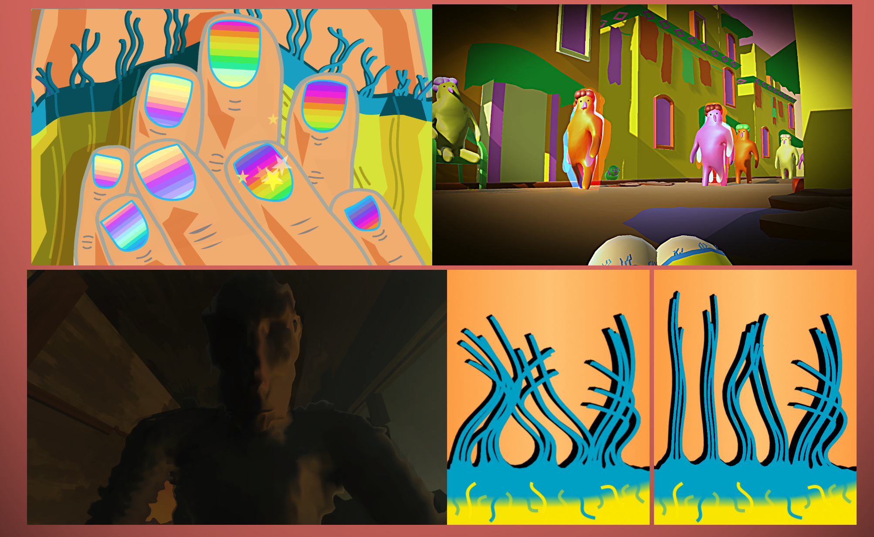
A Moment Free from Darkness
Notes:
Impressionistic 4 act game about being a sex slave
Played sequentially on 4 platforms to increase and then drop presence
Goals I had before this project:
I liked the idea of putting on VR headset for only part of game
Wanted to have player experience / see rape in a way that “worked.” Thoughtful disempowerment
Mention / show credits

Slide 20
Affordances of Head-mounted Virtual Reality
Strong sense of presence in space
Strong sense of embodiment in that space
Natural Head Input.
No longer 2D stick or 2D mouse
Natural Hand Input
No longer 2D stick or 2D mouse
Natural Body Input
No longer dead on a chair

Slide 21
Project #1
Review projects on website.

Slide 22
Project #1
Fantastic Non-human VR Toy
player is in a strange place
with an implied fantastic body
doing fun stuff

Slide 23
Strange Places
Yayoi Kusama
Richard Serra
Killing Fields
Củ Chi tunnels
The Holocaust History Museum - Yad Vashem
Dr. Strange by Steve Ditko

Slide 24
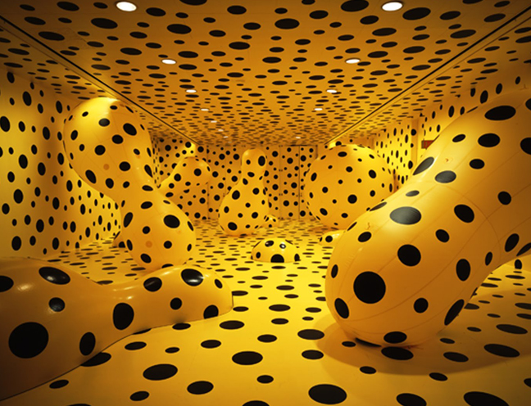
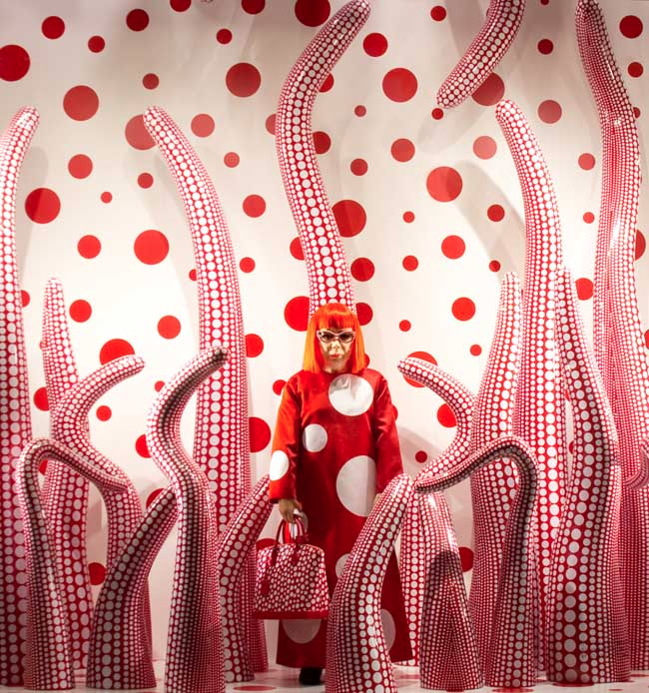
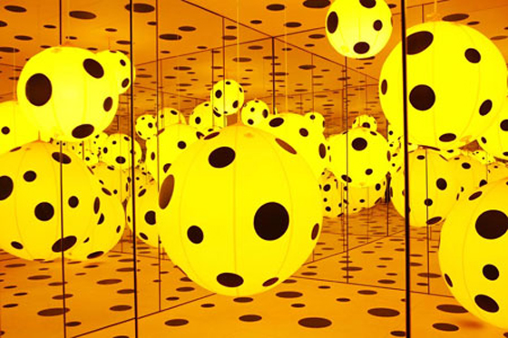
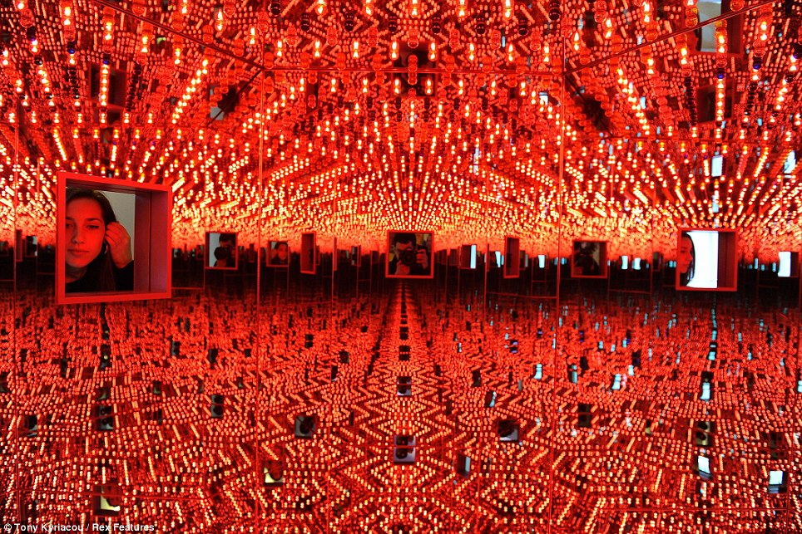
Yayoi Kusama

Slide 25
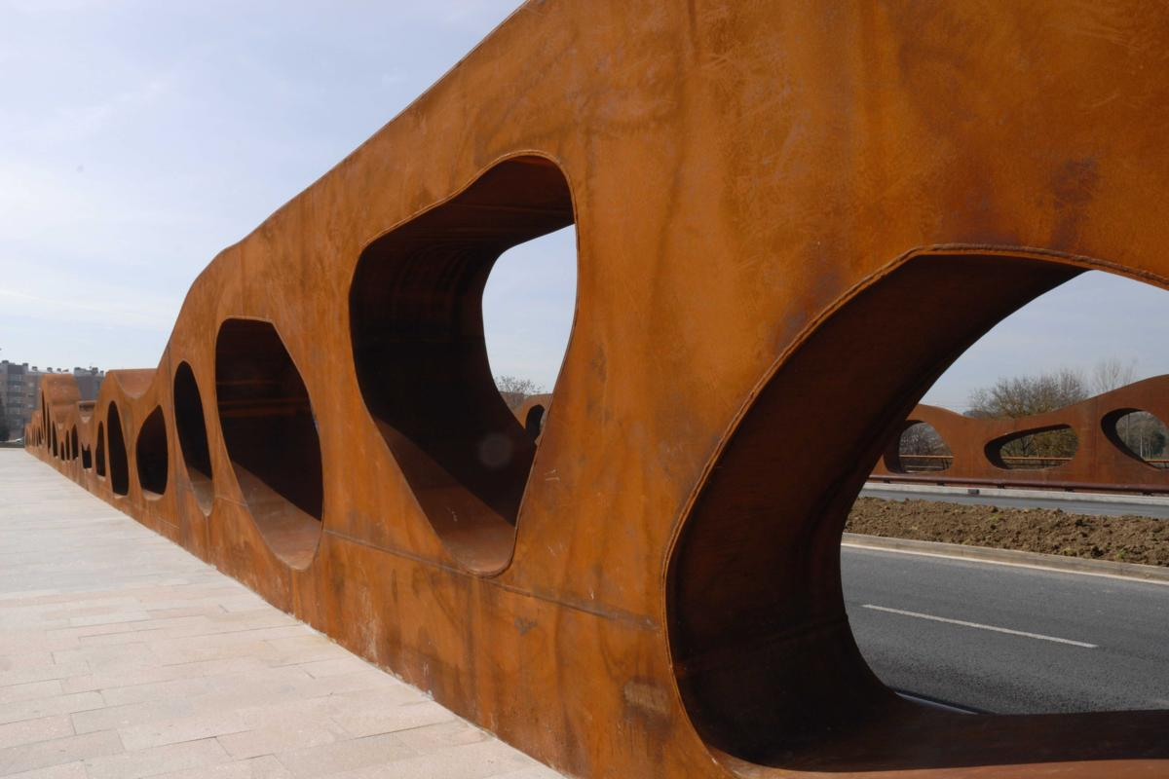
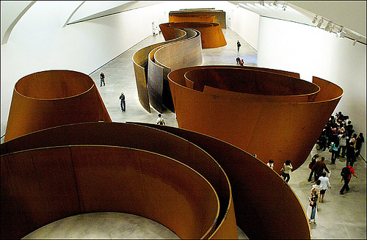
Richard Serra

Slide 26
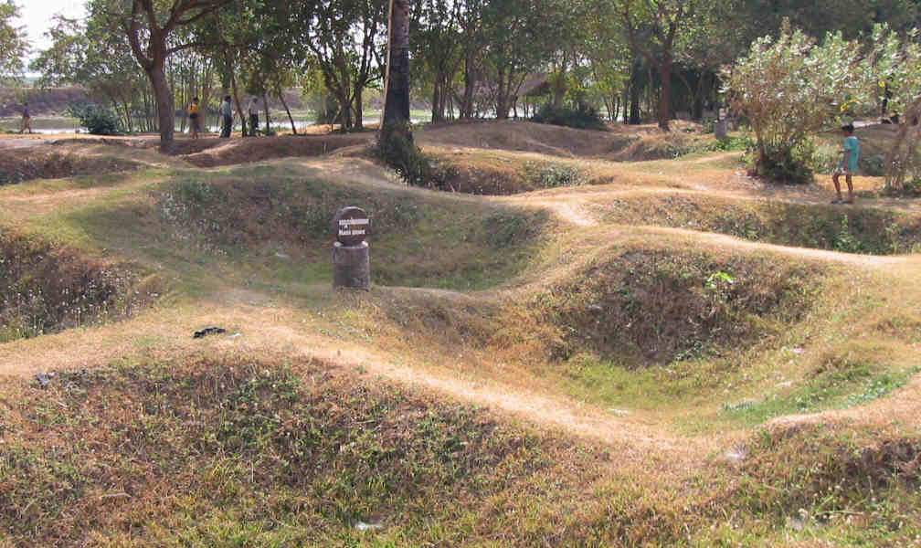
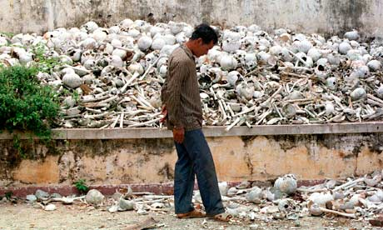
The Killing Fields (Cambodia)

Slide 27
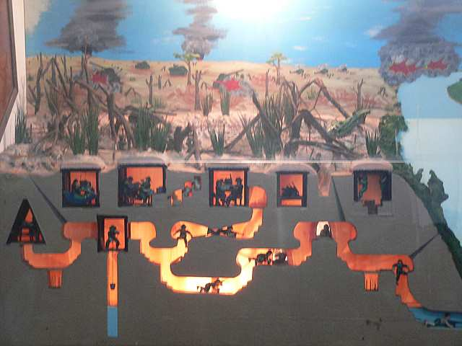
Củ Chi tunnels (Vietnam)

Slide 28
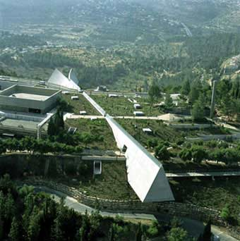
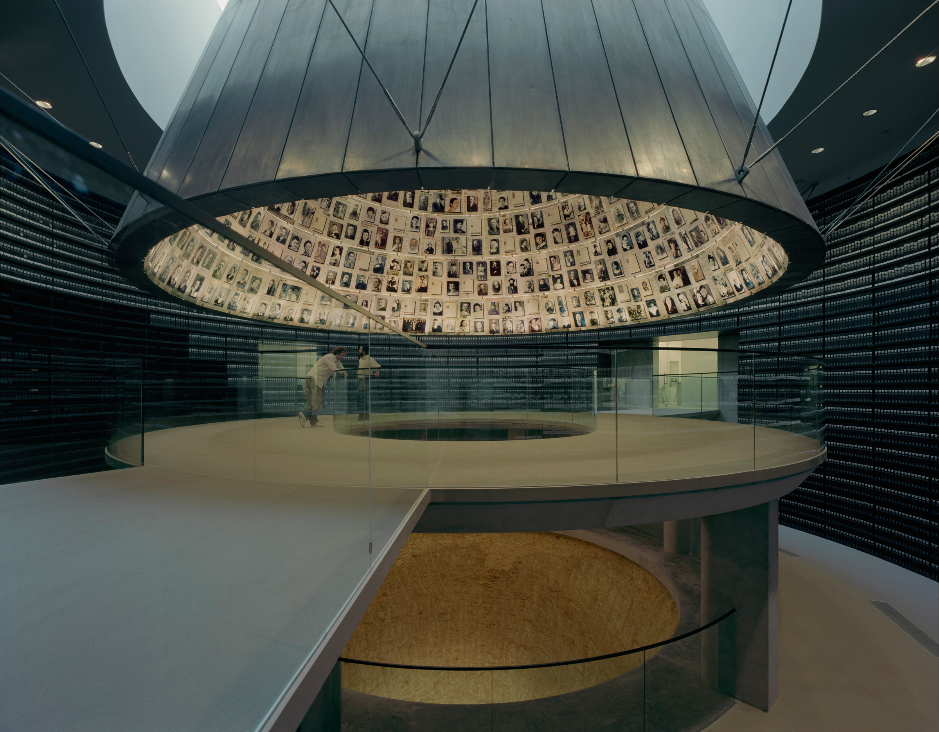
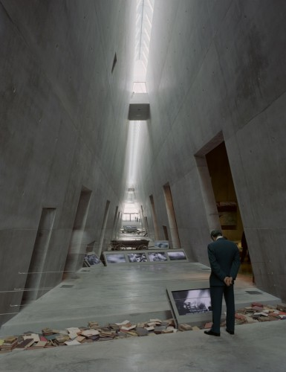
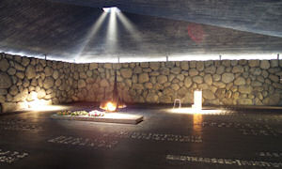
The Holocaust History Museum Yad Vashem

Slide 29
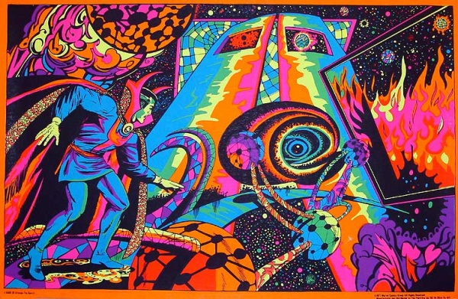
Dr. Strange by Steve Ditko (black light Poster)

Slide 30
MAKE IT UP! FILL IT UP!

Slide 31
Fantastic Places
What else??

Slide 32
Fantastic Bodies
District 9
The Thing
Furries
Bioclothes
Radiolaria

Slide 33
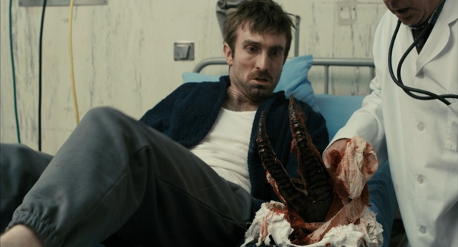
District 9

Slide 34
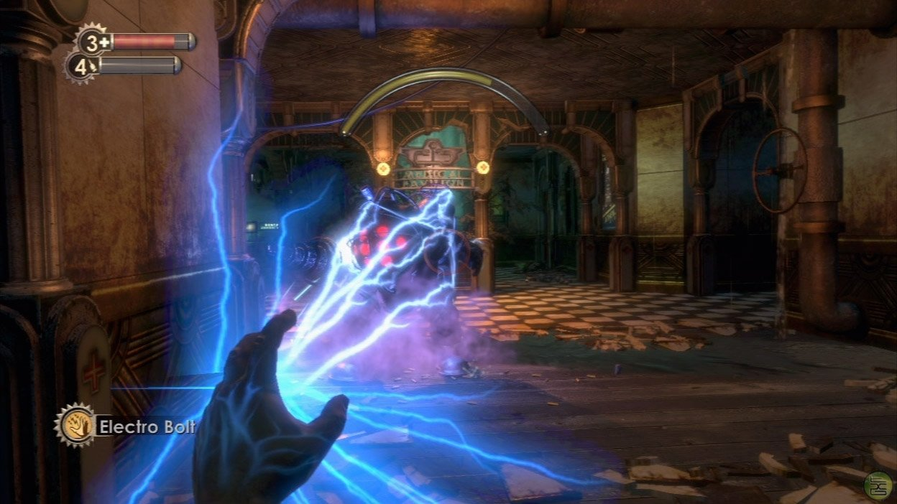
Augmented Hand is a tired trope

Slide 35
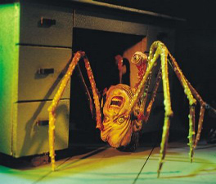
The Thing (John Carpenter)

Slide 36
Furries

Slide 37
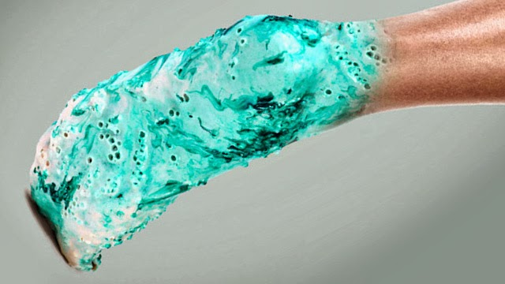
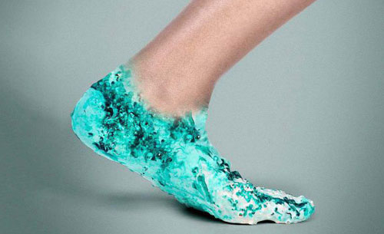
Bioclothes

Slide 38
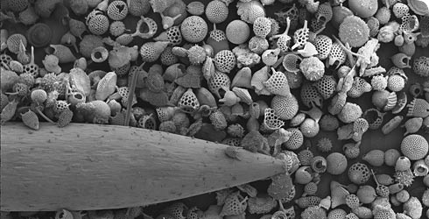
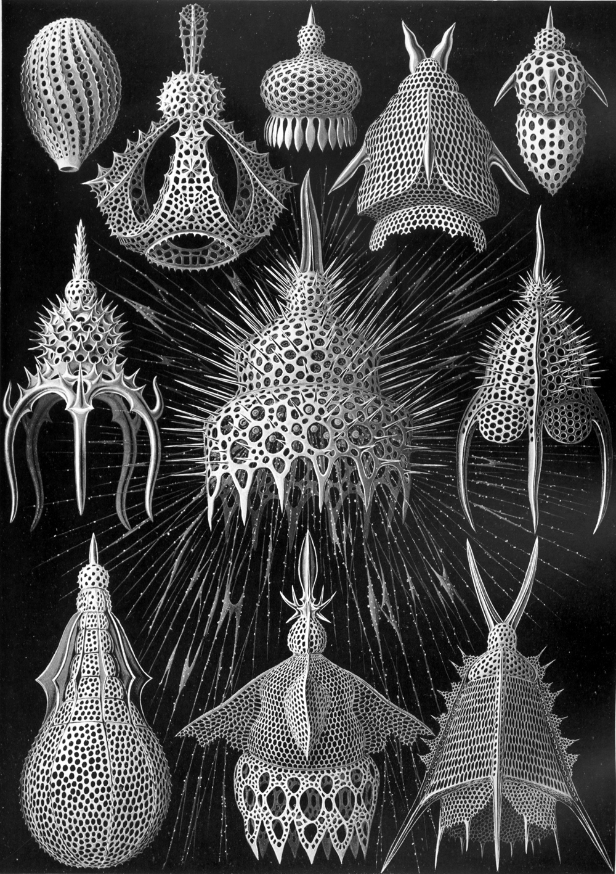
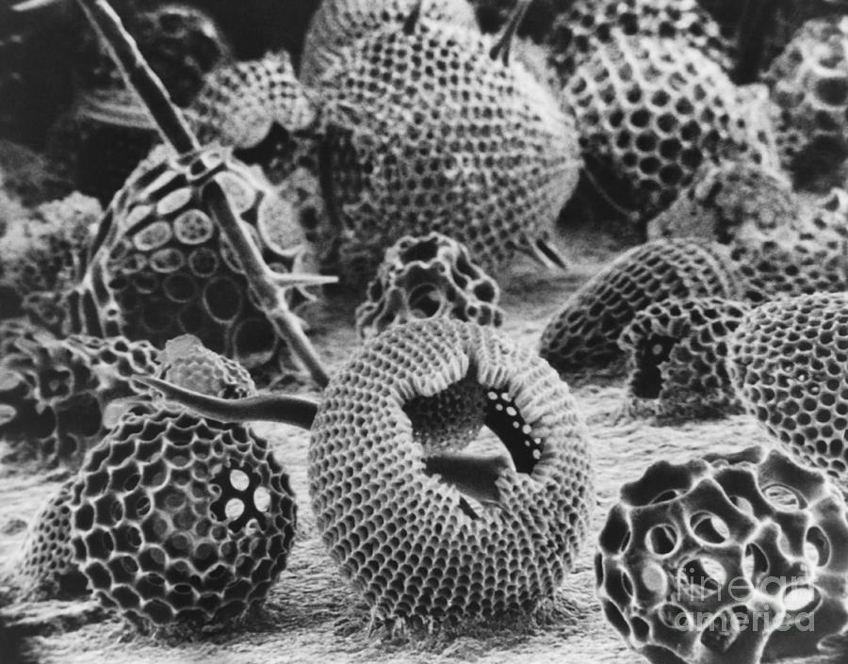
Radiolaria

Slide 39
Fantastic Bodies
What else??

Slide 40
Fantastic Senses
Geordi La Forge vision
Insect vision

Slide 41
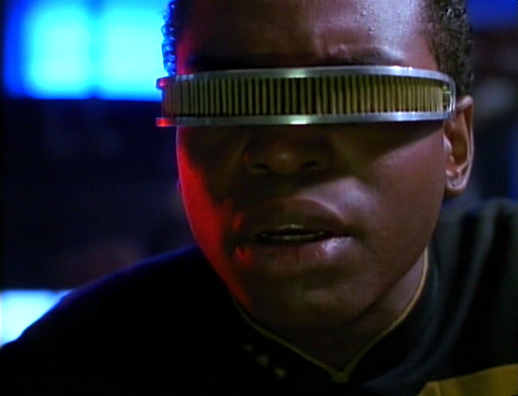
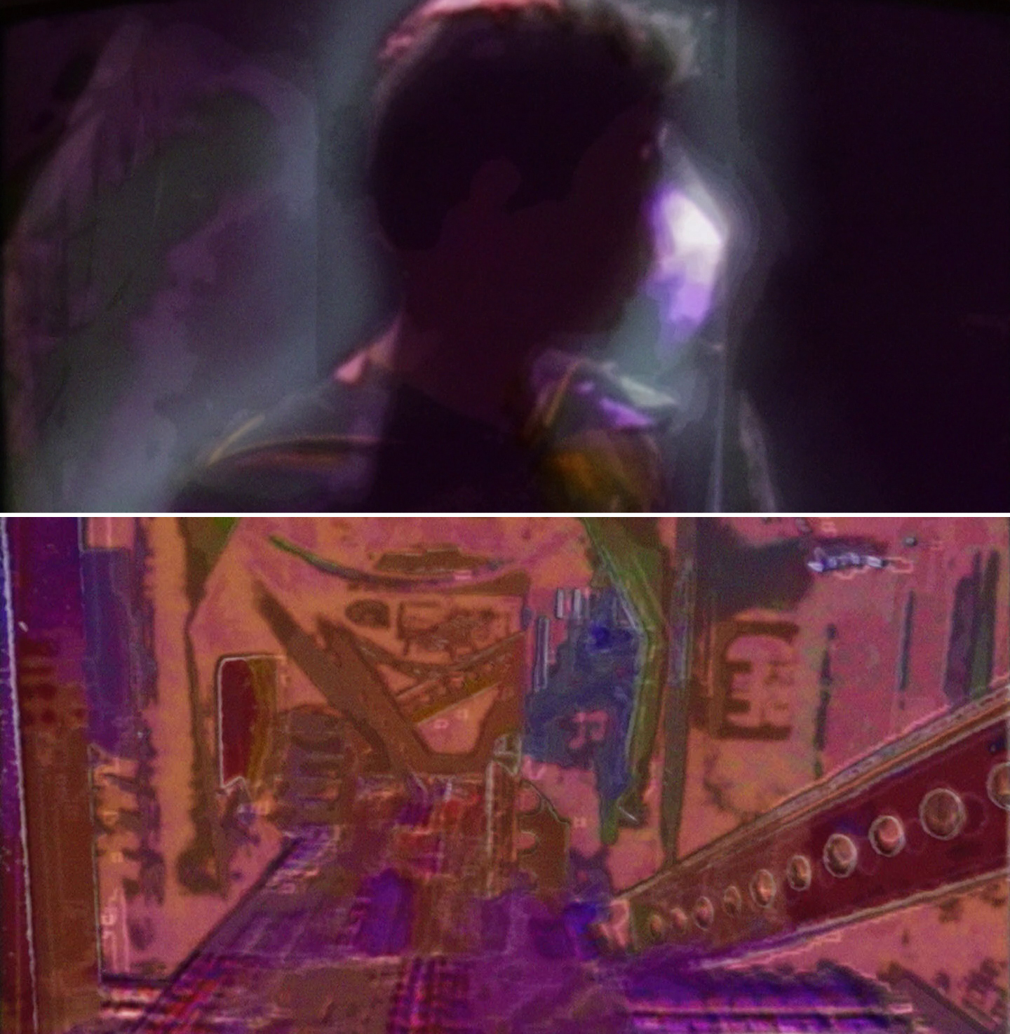
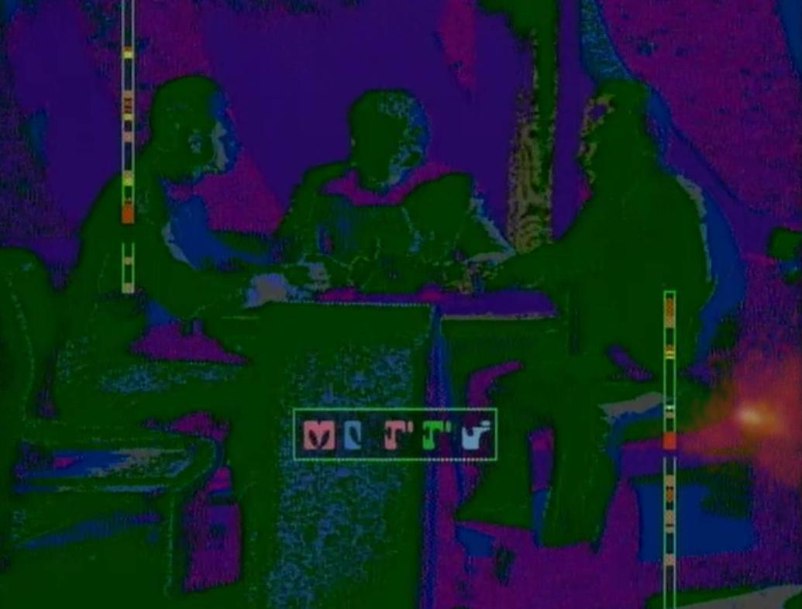
Geordi La Forge vision

Slide 42
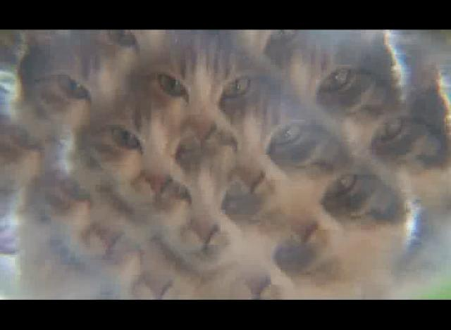
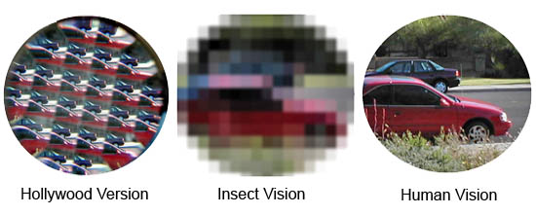
Insect vision

Slide 43
Fantastic Senses
What else??

Slide 44
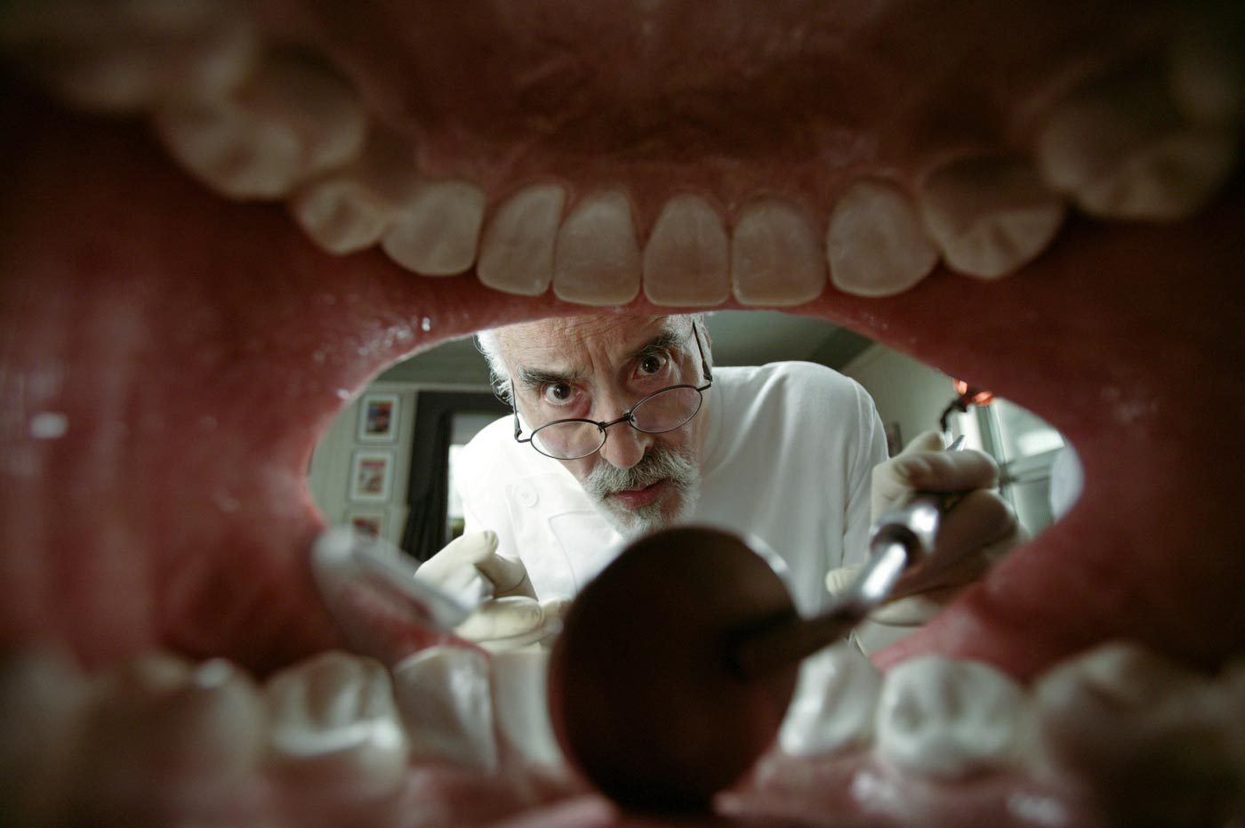
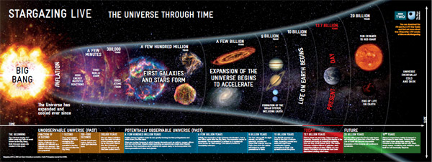
Fantastic Perspectives

Slide 45
Fantastic Perspectives
What else??

Slide 46
Project #1
Fantastic Non-human VR Toy
player is in a strange place
with an implied fantastic body
doing fun stuff

Slide 47
Fun Stuff?
easy to see HUGE effect of your actions in the world (over-the-top positive feedback)
toylike, playful, curiousity-inducing
not killing, shooting, or flying but…
slithering, teleporting, ascending
transforming, oozing, shifting
creating, spawning, replicating
slapping, flicking, kissing, birthing
squawking, bleating, croaking

Slide 48
Any Questions?

